Slide 1
Sheet 7
Back to Optimization & CNN

Slide 2
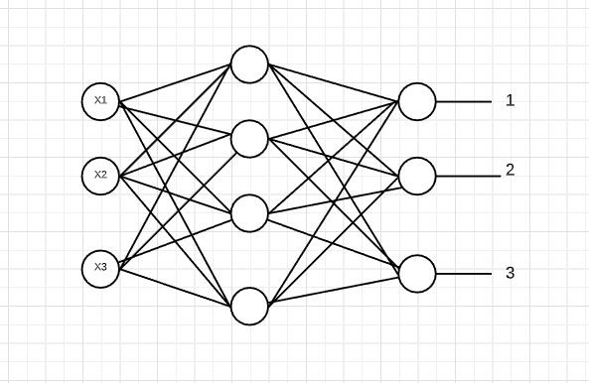






Q1) Assume a neural network with a single hidden layer and a soft-max at the output layer. Derive the gradient descent optimization update equation for the network parameters.

Slide 3










Slide 4
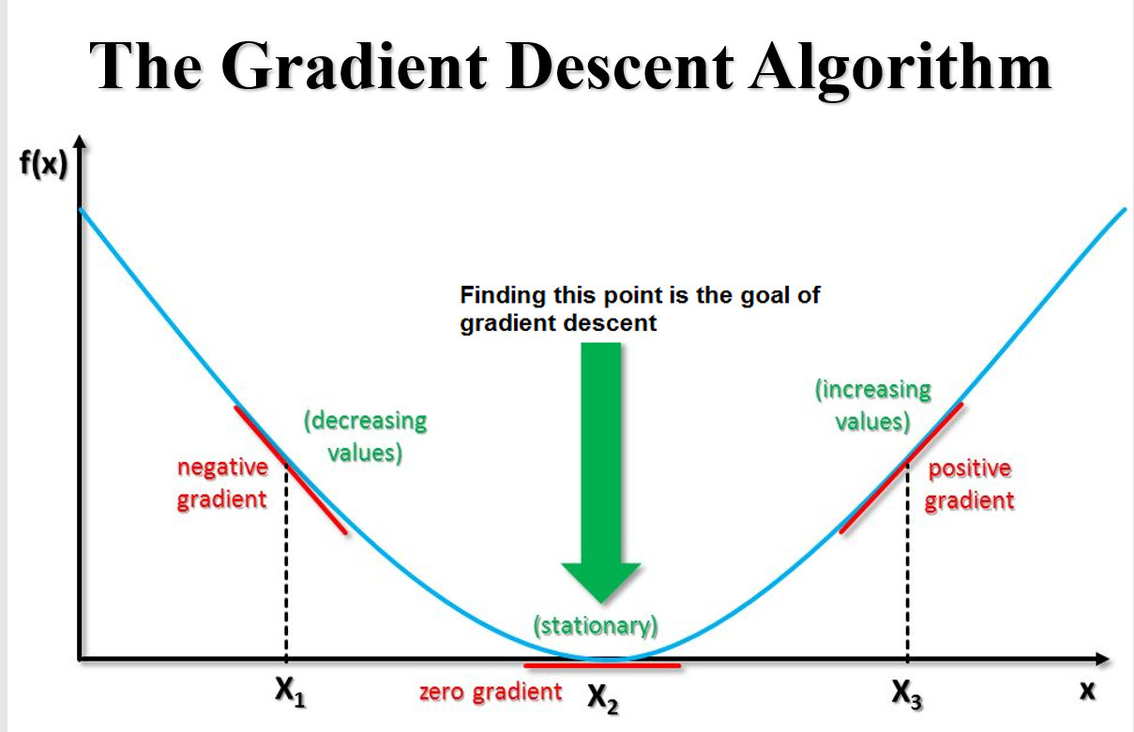
Optimization
1- Gradient Descent Algorithm
Online
Batch

Slide 5
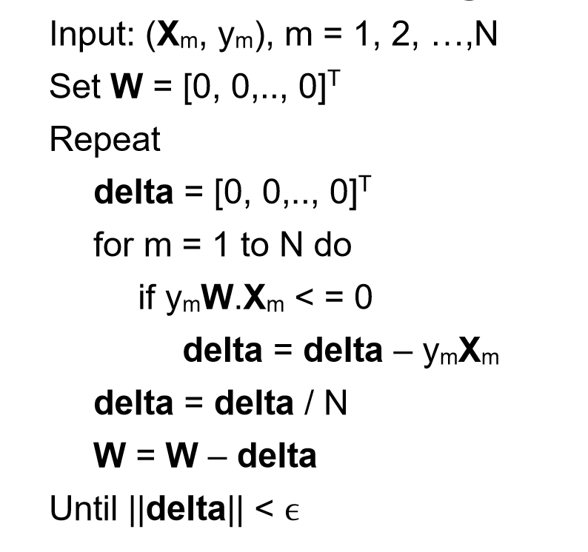
Batch

Slide 6

Problems
May trap at local minima.
Weights are changed after calculating gradient on the whole dataset. So, if the dataset is too large than this may take years to converge to the minima.
Requires large memory to calculate gradient on the whole dataset

Slide 7
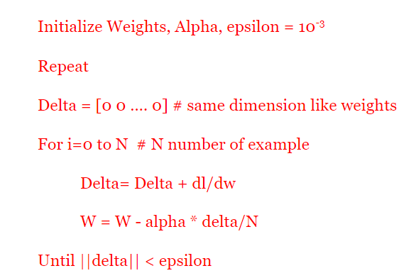
Online

Slide 8
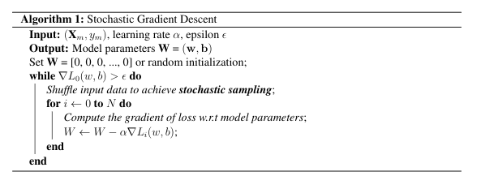
Problems
Stochastic gradient Descent (SGD)
Converging to a local minimum can be quite slow.
If there are multiple local minima, then there is no guarantee that the procedure will find the global minimum.

Slide 9
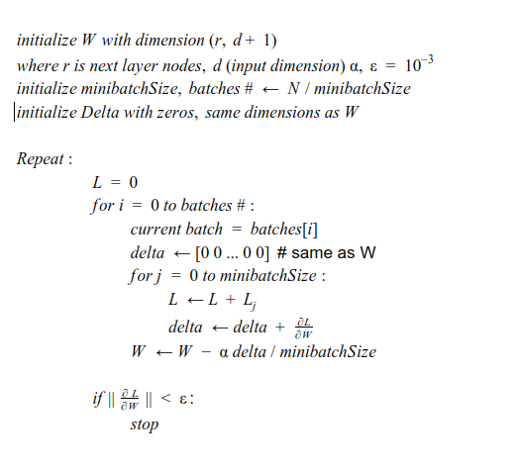
Mini Batch GD
Notes:
** n7ot dimension of the weights

Slide 10
Problems
Choosing an optimum value of the learning rate. If the learning rate is too small than gradient descent may take ages to converge.
Have a constant learning rate for all the parameters. There may be some parameters which we may not want to change at the same rate.
May get trapped at local minima.

Slide 11
Momentum
Momentum based gradient descent
It is a physics term; it refers to the quantity of motion that an object has.
Momentum = mass • velocity
It is like a ball rolling downhill. The ball will gain momentum as it rolls down the hill.

Slide 12
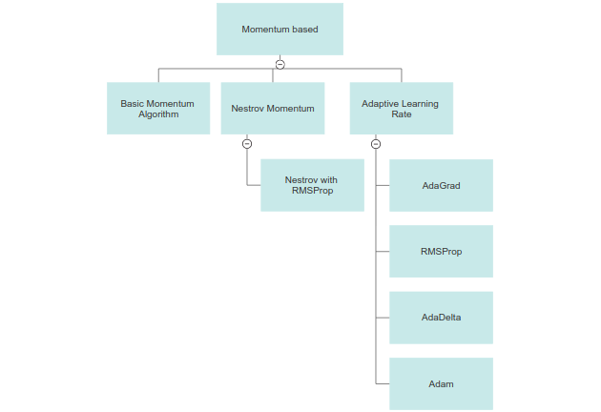
Momentum based gradient descent

Slide 13
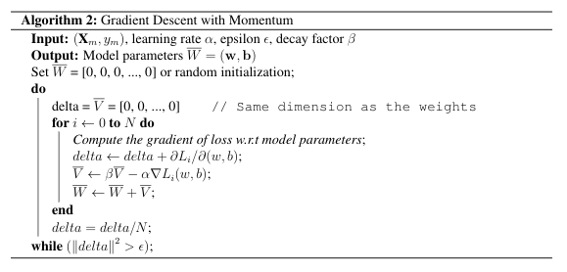
Problems
Momentum based gradient descent
One more hyper-parameter is added which needs to be selected manually and accurately.
Learning Rate is constant and initialized manually
If the momentum is too high it will miss the minimum (Overshooting)

Slide 14

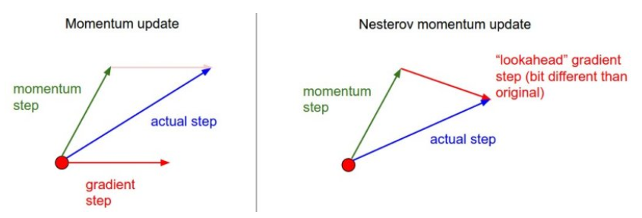
Improvements
Nesterov Momentum based gradient descent
Nesterov method achieves stronger convergence by applying the velocity to the parameters in order to compute update.
It also provides a lookahead gradient step to better reach reach destination.

Slide 15
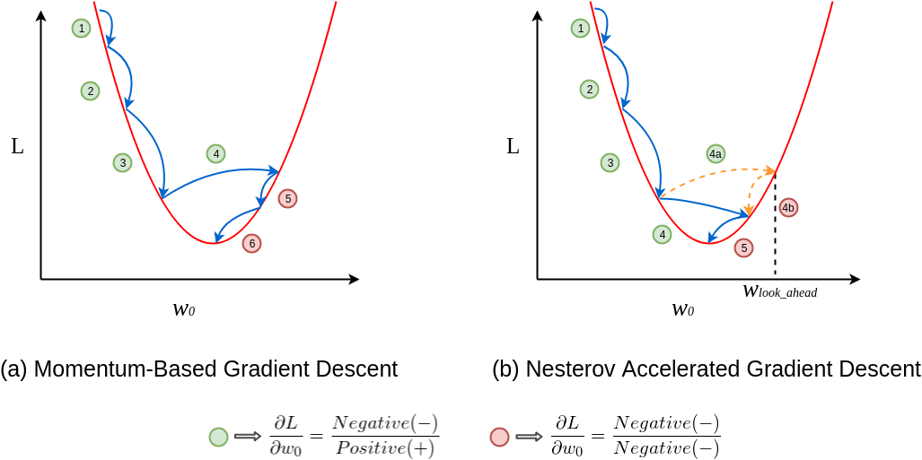
Nesterov Momentum based gradient descent

Slide 16
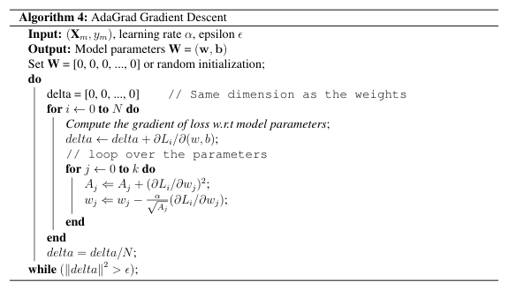
Benefits
AdaGrad gradient descent
Progress along “steep” directions is damped.
Progress along “flat” directions is accelerated.
If it does not converge, step size decays to zero

Slide 17
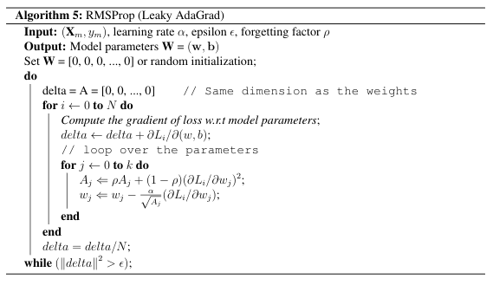
Benefits
RMSProp
gradient descent
Progress along “steep” directions is damped.
Progress along “flat” directions is accelerated.
If it does not converge, step size decays to zero

Slide 18
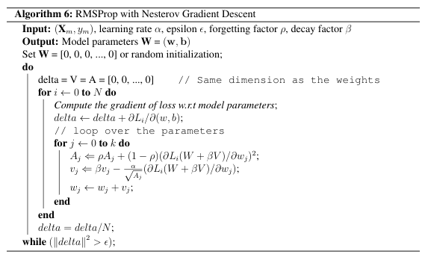
RMSProp with Nesterov gradient descent

Slide 19
Problems
Computationally expensive.
The learning rate is always decreasing results in slow training.

Slide 20
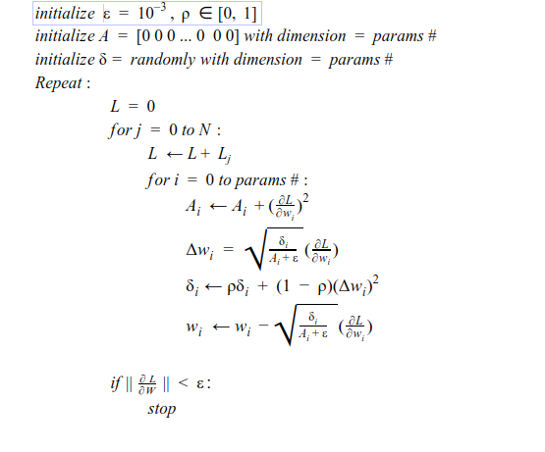
AdaDelta
gradient descent

Slide 21
Problems
Computationally expensive

Slide 22
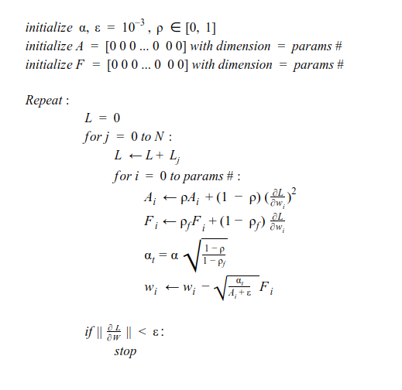
Adam

Slide 23
Q5) Derive the parameters update rule using the NR-GD technique. Is this approach practical in training DNNs? Justify your answer. What are the algorithms that overcome the limitation of such a technique?
Not practical, in a practical NN, the Hessian Matrix is very large to store or compute let along compute its inverse.
Algorithms to overcome limitation: quasi Newton Methods, Hessian Free Optimization, L-BFGS

Slide 24
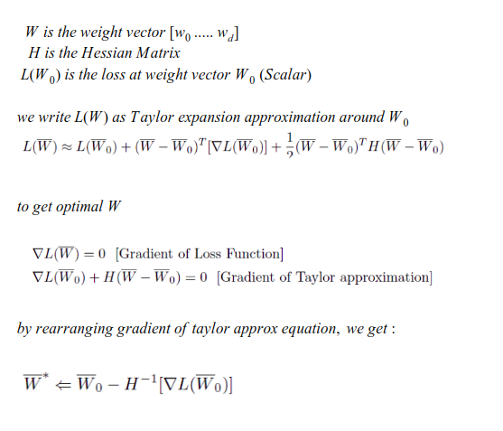

Slide 25
Q3) Describe the behavior of SGD when dealing with a saddle point. Compare it with the other modern techniques.
SGD | Got fooled for the saddle point
Momentum | It won’t get stuck because of the momentum
NAG | It will get stuck for a while then converge fast
AdaGrad | progress along “flat” directions is accelerated
Rmsprop | progress along “flat” directions is accelerated and more smooth
AdaDelta | It converges faster

Slide 26
Q4) Compare the performance of the modern gradient descent optimization techniques against the SGD
SGD | Less computational expensive, slower to converge it can get stuck in saddle point or get trapped in local min
Momentum | It converges faster than SGD but it can overshoot
NAG | It converges faster than Momentum, It slows down before min
AdaGrad | It converges faster than NAG
Rmsprop | It converges faster than AdaGrad but in saddle points it is accelerated and more smooth
AdaDelta | It reached faster than Adagrad and Rmsprop

Slide 27
Q6) Describe how to overcome the vanishing gradients problem? How does this problem affect the training of neural networks?
A problem with training networks with many layers (e.g. deep neural networks) is that the gradient diminishes dramatically as it is propagated backward through the network. The error may be so small by the time it reaches layers close to the input of the model that it may have very little effect. As such, this problem is referred to as the “vanishing gradients” problem
This can be overcome by:
Choosing activation functions with higher gradient value (ReLU).
Batch normalizations technique.

Slide 28
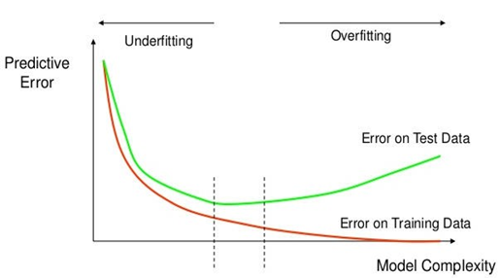
Q7) What is the overfitting problem? How to avoid such a problem when training neural networks?
Overfitting happens when the Neural Network starts to over tune its parameters that it becomes specific for only the training dataset. In this case, the error in predicting the training samples becomes very low (almost zero) while the performance in the testing dataset increases. It’s said that the network failed to generalize.
This can be avoided by:
Using a validation dataset to check how generalized is the network.
Data augmentation to increase variations in the training dataset.
Using Drop out and batch normalization techniques.

Slide 29
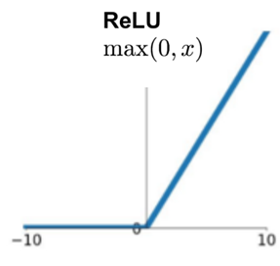
Q8) What is the relation between ReLUs and drop out?
The output of ReLU is 0 for all negative numbers, which means that this node is “shut down” during calculation of this sample or batch. It’s doesn’t contribute neither in output nor in backpropagation.
This behavior is similar to the drop out technique which involves shutting down a percentage of the nodes during both feedforward and backpropagation.
Both are proven to increase the ability of the network to generalize and achieve better results in the testing dataset.

Slide 30
Q9) How to obtain the ideal structure of your neural network?
Experimentation: Empirical trial and error with concrete evaluation metrics
Fine Tuning: Borrowing other architectures and tune them for my problem has been proven to be a solid idea for usage.
Architecture Search: the term AutoML or Automatic Machine Learning is one of the hottest topics in research right now because of its ability to search in design spaces and come up with a close ideal structure for a neural network to the problem specified as input.

Slide 31
Q10) List some optimization techniques that avoid the fixed learning rate problem.
AdaGrad gradient descent optimization
RMSProp with Nesterov gradient descent optimization
AdaDelta gradient descent optimization
Adam gradient descent optimization

Slide 32
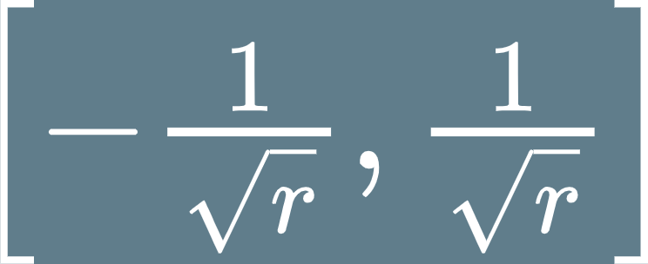
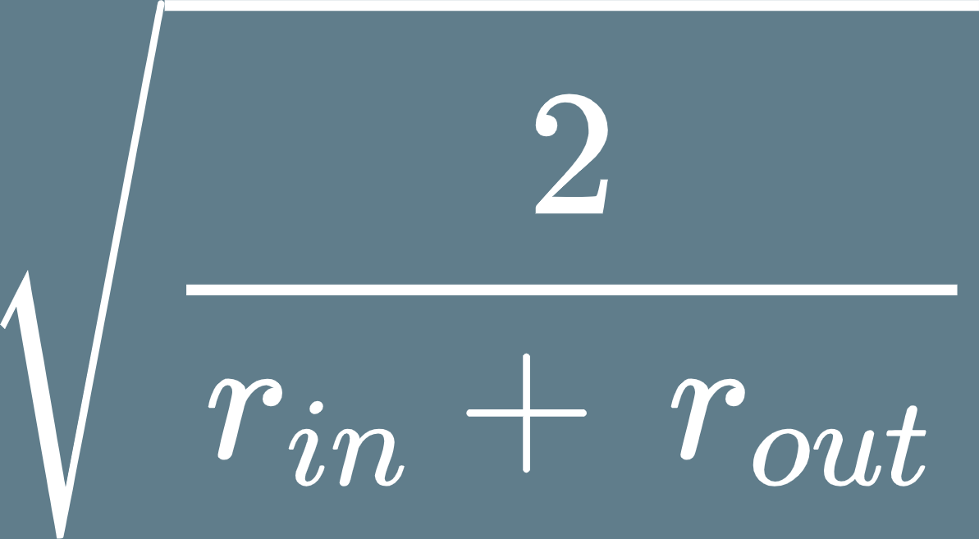
Q11) How to initialize training parameters?
Random Initialization from a Gaussian Distribution (centred around zero)
Bonus (Not mandatory)
Uniform distribution in range
Gaussian distribution with mean of 0 and standard deviation of 1/√r Where 𝑟 is the number of input nodes
Xavier initialization suggests initialization of weights by Gaussian distribution of mean 0 and standard deviation that is different in each layer according to following equation (old)
Where 𝑟_{𝑖𝑛} and 𝑟_{𝑜𝑢𝑡} are the number of inputs and outputs of the layer respectively
Source to understand Xavier Initialization: https://prateekvjoshi.com/2016/03/29/understanding-xavier-initialization-in-deep-neural-networks/

Slide 33
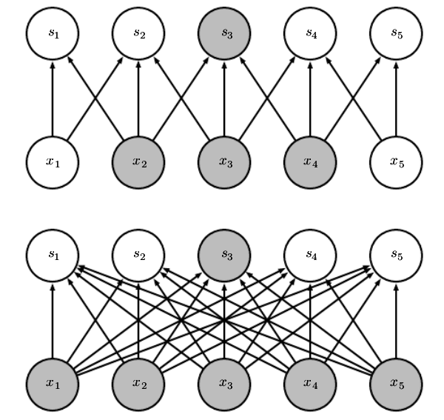
Q12) What are the main three properties of CNN? Which part of the network is related to which property?
The main three properties of CNN:
Locally Connected (Sparse Interactions): As some patterns are smaller than the whole image, a neuron doesn’t have to see the whole image to detect the pattern. Such neuron are connected to only part of the previous layer output (less parameters)

Slide 34
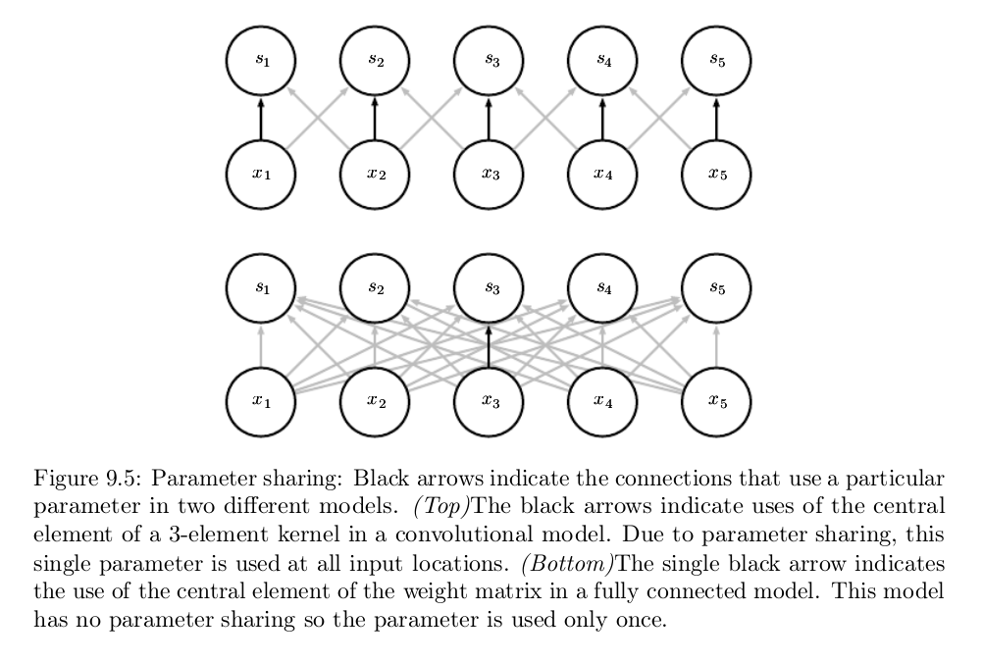
The main three properties of CNN:
2. Parameter Sharing: As the same pattern may exist in different regions of image, two or more neurons may end up doing almost the same thing. These neurons can share the same set of parameters.

Slide 35
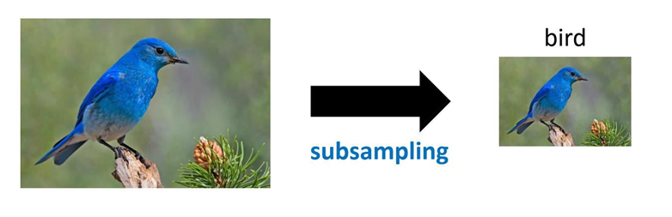
The main three properties of CNN:
3. Subsampling(Pooling): As subsampling the image will not change the object. We can subsample the pixels to get smaller image which means less network parameters.
**The first two properties are related to the convolution layers while the last property is related to the pooling layer.

Slide 36
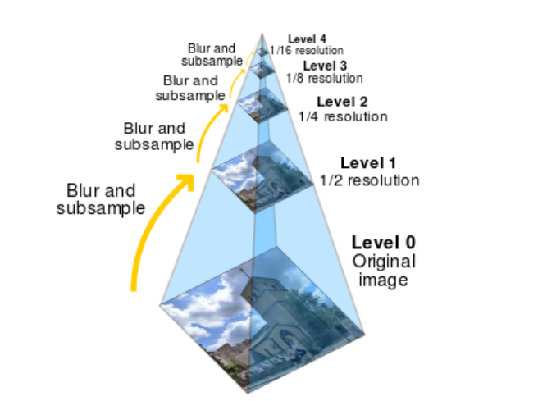
Q13) How can an object be recognized under different scales using a CNN network?
Going through Convolution and Pooling the first layers’ perceptive fields are narrow and focus on small objects while later layers have a wider field of view and can detect large objects easier.
Bonus (Feature Pyramid Networks)

Slide 37
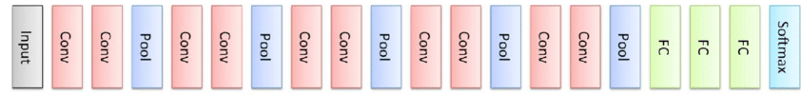
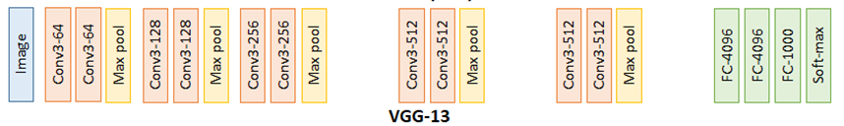
Q14) For the VGGNET structure given below, assume that the filter size is 3X3 in the convolutional layers with a stride and a padding amount of 1. Discuss and calculate the size of each stage.

Slide 38
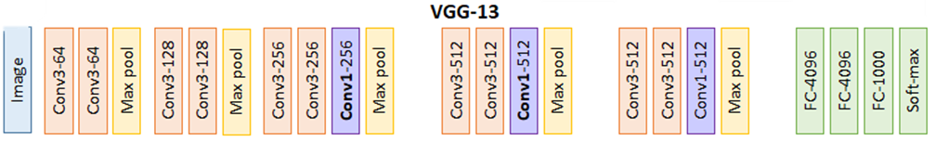
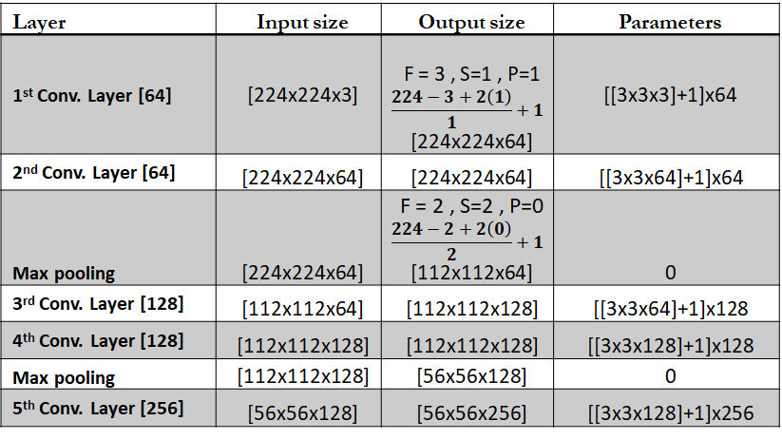
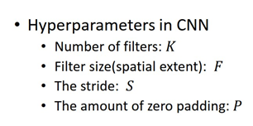
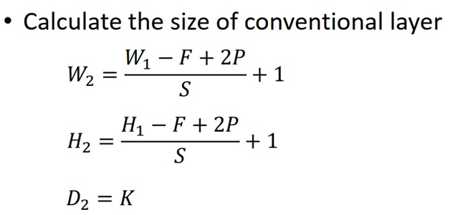

Slide 39
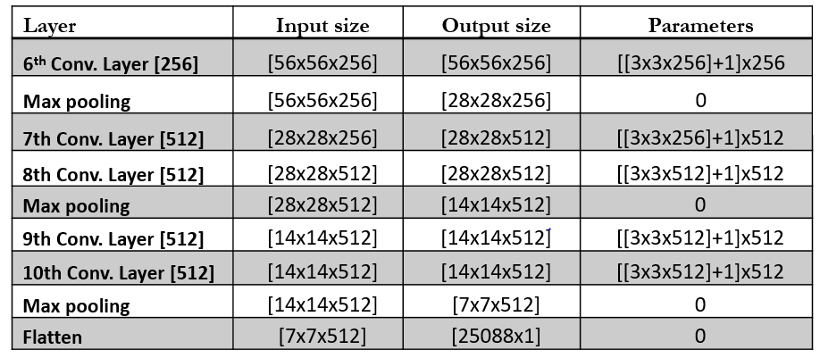

Slide 40
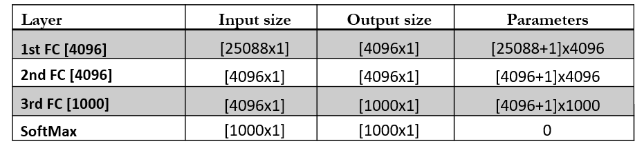

Slide 41
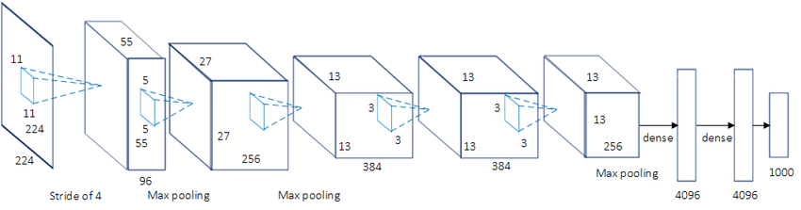
Q15) The following CNN architecture is called AlexNet:-
Discuss the network stages' different structures listing i) filter sizes, ii) stride and padding amounts, and iii) max-pooling sizes.

Slide 42
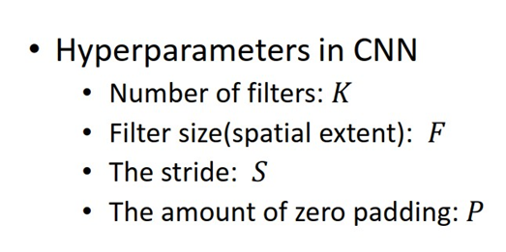

Slide 43
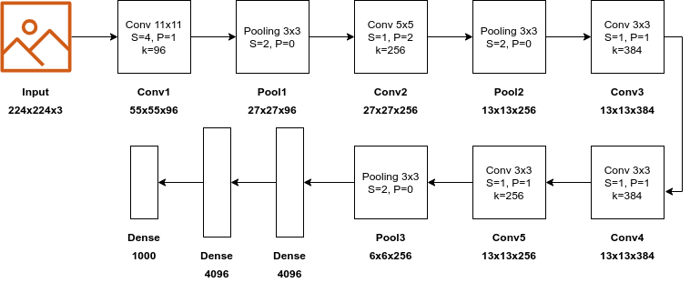
AlexNet
Padding = 2

Slide 44

Thank You

